Slide 1
Mission-driven Leadership
Roanoke Valley Governor’s School
Mary Dana Hinton, Ph.D.
President
Hollins University
Notes:
\

Slide 2
“Before I can tell my life what I want to do with it, I must listen to my life telling me who I am.”
– Parker Palmer

Slide 3
What is your mission in life?

Slide 4
Having a mission:
Enables leaders to sustain themselves
Demands a level of vulnerability in order to lead Allows you to act on opportunities
Connects you to this time and place

Slide 5
What in your life sparked your mission?
When was your spark born?
What sustains you in the face of challenges?

Slide 6
Vulnerability is the birthplace of innovation, creativity and change. – Brene Brown

Slide 7
What are your points of vulnerability that make you strong?

Slide 8
There is no greater agony than bearing an untold story inside you.
– Maya Angelou

Slide 9
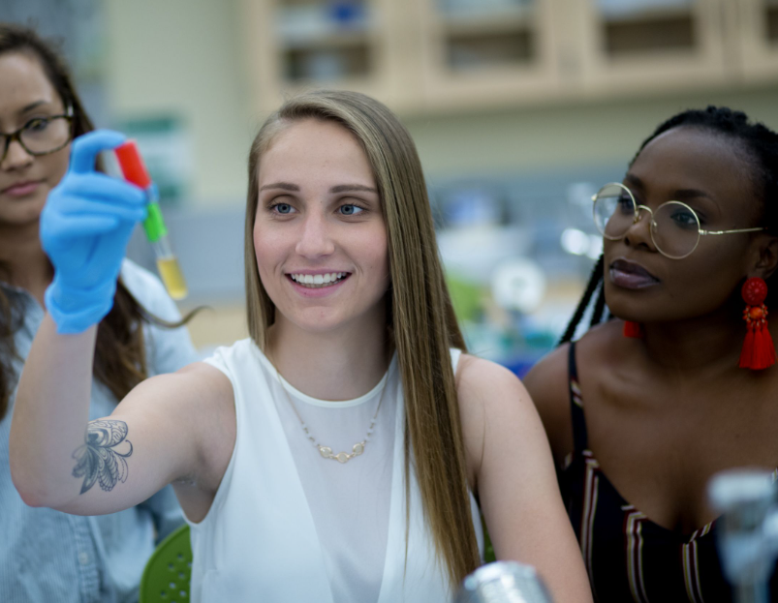
How can you share your story to inspire another?
How can you listen to the story of another with the ear of an open heart?
How can we be vulnerable in order to unlock our leadership potential?

Slide 10
Afraid that our inner light will be extinguished or our inner darkness exposed, we hide our true identities from each other. In the process, we become separated from our own souls.
We end up living divided lives, so far removed from the truth we hold within that we cannot know the ‘integrity that comes from being what you are.
– Parker Palmer
Notes:
\

Slide 11
If you are not taking the time to set your own goals, chances are pretty high someone else is doing it for you. So don't be surprised someday when you end up someplace you never hoped to be. – Mark W. Boyer

Slide 12
What opportunities are ahead of you that are worthy of your mission?
Are you currently engaging in activities that leave you divided? Why?

Slide 13
The future is not a result of choices among alternative paths offered by the present, but a place that is created
-created first in mind and will, created next in activity.
The future is not some place we are going to, but one we are creating.
The paths to it are not found but made, and the activity of making them changes both the maker and the destination.
– John Schaar

Slide 14
Contact Me
presoffc@hollins.edu
@hollinsadmission
@HollinsU
Hollins University @HollinsUniversity

