Slide 1
LEADING A LASTING MOVEMENT
Del. Sam Rasoul | DelSrasoul@House.Virginia.Gov

Slide 2
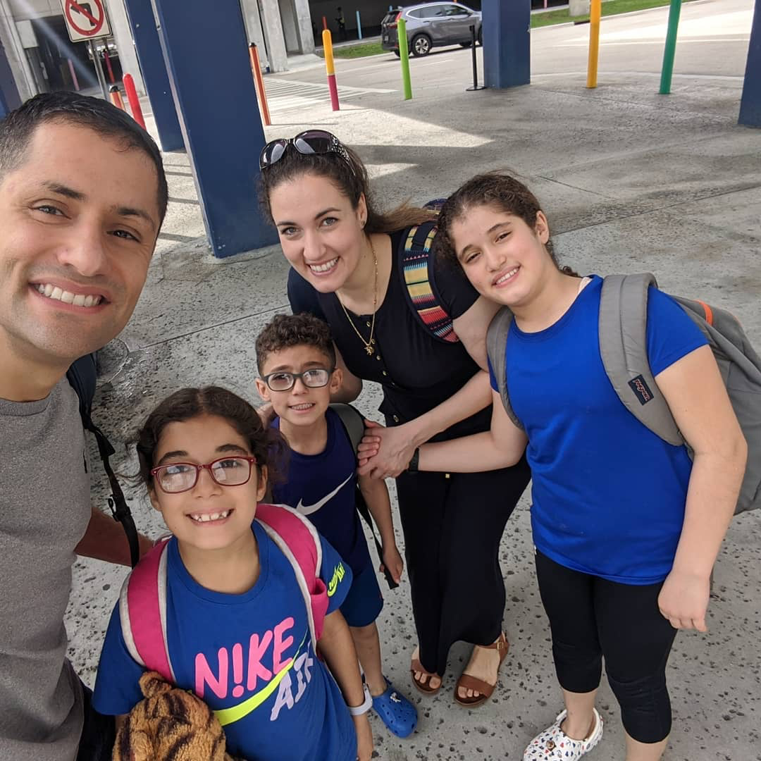
DEL. SAM RASOUL
Representative for the 11th District in the Virginia House of Delegates
Grew up in my parents' corner store, a community hub
Married to Layaly, and have 3 beautiful children
Works as an organizational strategist, and offers leadership development training
T & I: @Sam_Rasoul

Slide 3
THE SCIENCE OF CONNECTING:
1
Spreading the message through trust

Slide 4
Which leaders do
YOU TRUST & WHY?

Slide 5
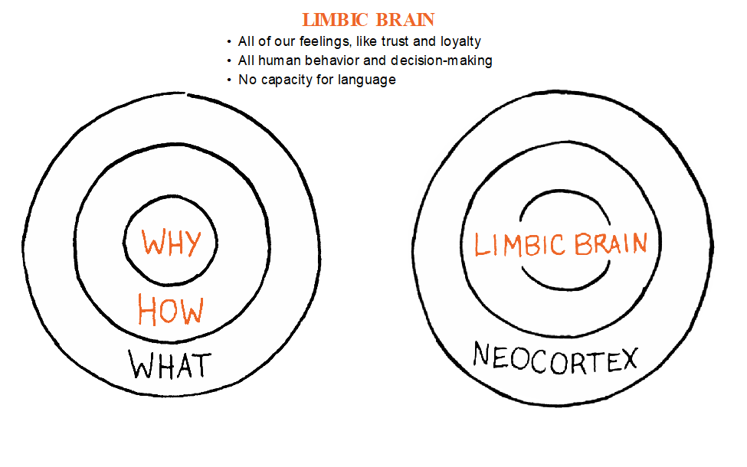
THE NEUROSCIENCE BEHIND WHY

Slide 6
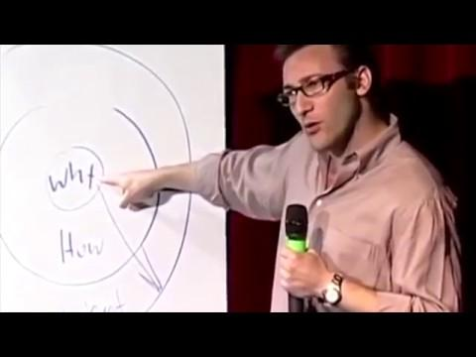
“
People don’t buy what you do,
they buy why you do it.
“
https://www.youtube.com/watch?v=8OuA4SniKVY&feature=youtu.be

Slide 7
What’s your “WHY?”
BUILD YOUR MOVEMENT

Slide 8
EXAMPLES OF VALUES
Integrity: Always do the right thing
Empathy: Put yourself in their shoes
Community: Love thy neighbor
Dependable/Trusted: You can count on me
Humility: Listen, & listen more
Family/Fairness: Treating you like family
Respect: Treat others the way you want to be treated
Good Stewards: We care for everyone & everything
Member-driven: Service is who we are
Transparent: Ask me anything!
Safety: Keeping each other safe
Innovative: Seek a better way
Empowerment: I empower you
Encourage Feedback: I love to grow!

Slide 9
LIVING YOUR VALUES
HOW STUFF
How exactly will we live them?
Living our values speaks to the “gut.”
LIVING YOUR VALUES ALWAYS HAS A COST
theimpact.center | @ImpactCenterVA

Slide 10
WHAT YOUR VALUES COST
Empathy: Put yourself in their shoes
Good Stewards: We care for everyone &
everything
Integrity: Always do the right thing
Time, energy
Resources, integrity
Money, votes
theimpact.center | @ImpactCenterVA

Slide 11
What is a value & a cost
in your life?
BUILD YOUR MOVEMENT

Slide 12
UNDERSTANDING YOUR CROWD:
2
Eliminating barriers & communicating with New Power

Slide 13
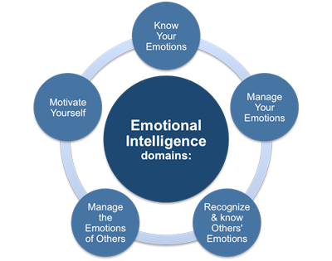
WHAT IS EMOTIONAL INTELLIGENCE?
Person’s ability to perceive, control, evaluate, and express emotions
Measured using Emotional Quotient (EQ)
90% correlation with highly emotionally intelligent individuals and top performers
theimpact.center | @ImpactCenterVA

Slide 14
theimpact.center | @ImpactCenterVA

Slide 15
SELF-AWARENESS
theimpact.center | @ImpactCenterVA

Slide 16
SELF-AWARENESS
theimpact.center | @ImpactCenterVA

Slide 17
How could your EQ hinder your movement?
BUILD YOUR MOVEMENT
EXAMPLE:
I lack empathy, making it difficult for me to bring people into the fold.

Slide 18
THE RIGHTEOUS MIND: MORAL MATRIX
1. CARE/HARM FOUNDATION: Empathy, We’re sensitive to signs of suffering and need,
2. LIBERTY/OPPRESSION FOUNDATION: Freedom, The left wants liberty for the underdogs and victims, the right wants liberty from government intrusion.
3. FAIRNESS/CHEATING FOUNDATION: Equitable, Equality vs. Proportionality, Left: Fairness=Equality, Right Fairness=Proportionality “you get what you put in, and that’s not always equal.”
4. LOYALTY/BETRAYAL FOUNDATION: Tribalism, Universalism vs. Nationalism
5. AUTHORITY/SUBVERSION FOUNDATION: Order, fends off chaos; the right values this foundation, while the left defines itself by opposing hierarchy, inequality, and power.
6. SANCTITY/DEGRADATION FOUNDATION: Purity, ideals such as environmentalism, or marriage
THE RIGHTEOUS MIND: MORAL MATRIX
theimpact.center | @ImpactCenterVA

Slide 19
LIBERAL MORAL MATRIX
theimpact.center | @ImpactCenterVA

Slide 20
SOCIAL CONSERVATIVE MORAL MATRIX
theimpact.center | @ImpactCenterVA

Slide 21
Questions?

Slide 22
Takeaways

Slide 23
Week 4 Reflection Activity Part 1 (6/29)
Too often, people don’t consider the best ways to collaborate with team members to brainstorm new ideas and just lump that in as that part of the decision-making process. While that can be part of the early stages of decision-making, communication and collaboration can be stifled without proper focus on optimal methods to encourage quality teamwork.
Conduct a brief interview of an adult family member or trusted adult, asking about a time at work where a decision needed to be made in a meeting or team setting (either a positive of negative experience will work). Ask questions along these lines:
Did you feel welcome to share your ideas during the discussion? Do you think all team members shared ideas freely? If the previous answers aren’t the same, why do you think that was? Did people become connected to their favorite ideas? Did tension arise anywhere in the process? If they didn’t lead the meeting, what do they think leader have done to promote increased collaboration? If they were the leader, is there anything they wish they had done differently to encourage collaboration/what worked well? Be prepared to share the insights you received at the next session (Thursday).

